Slide 1
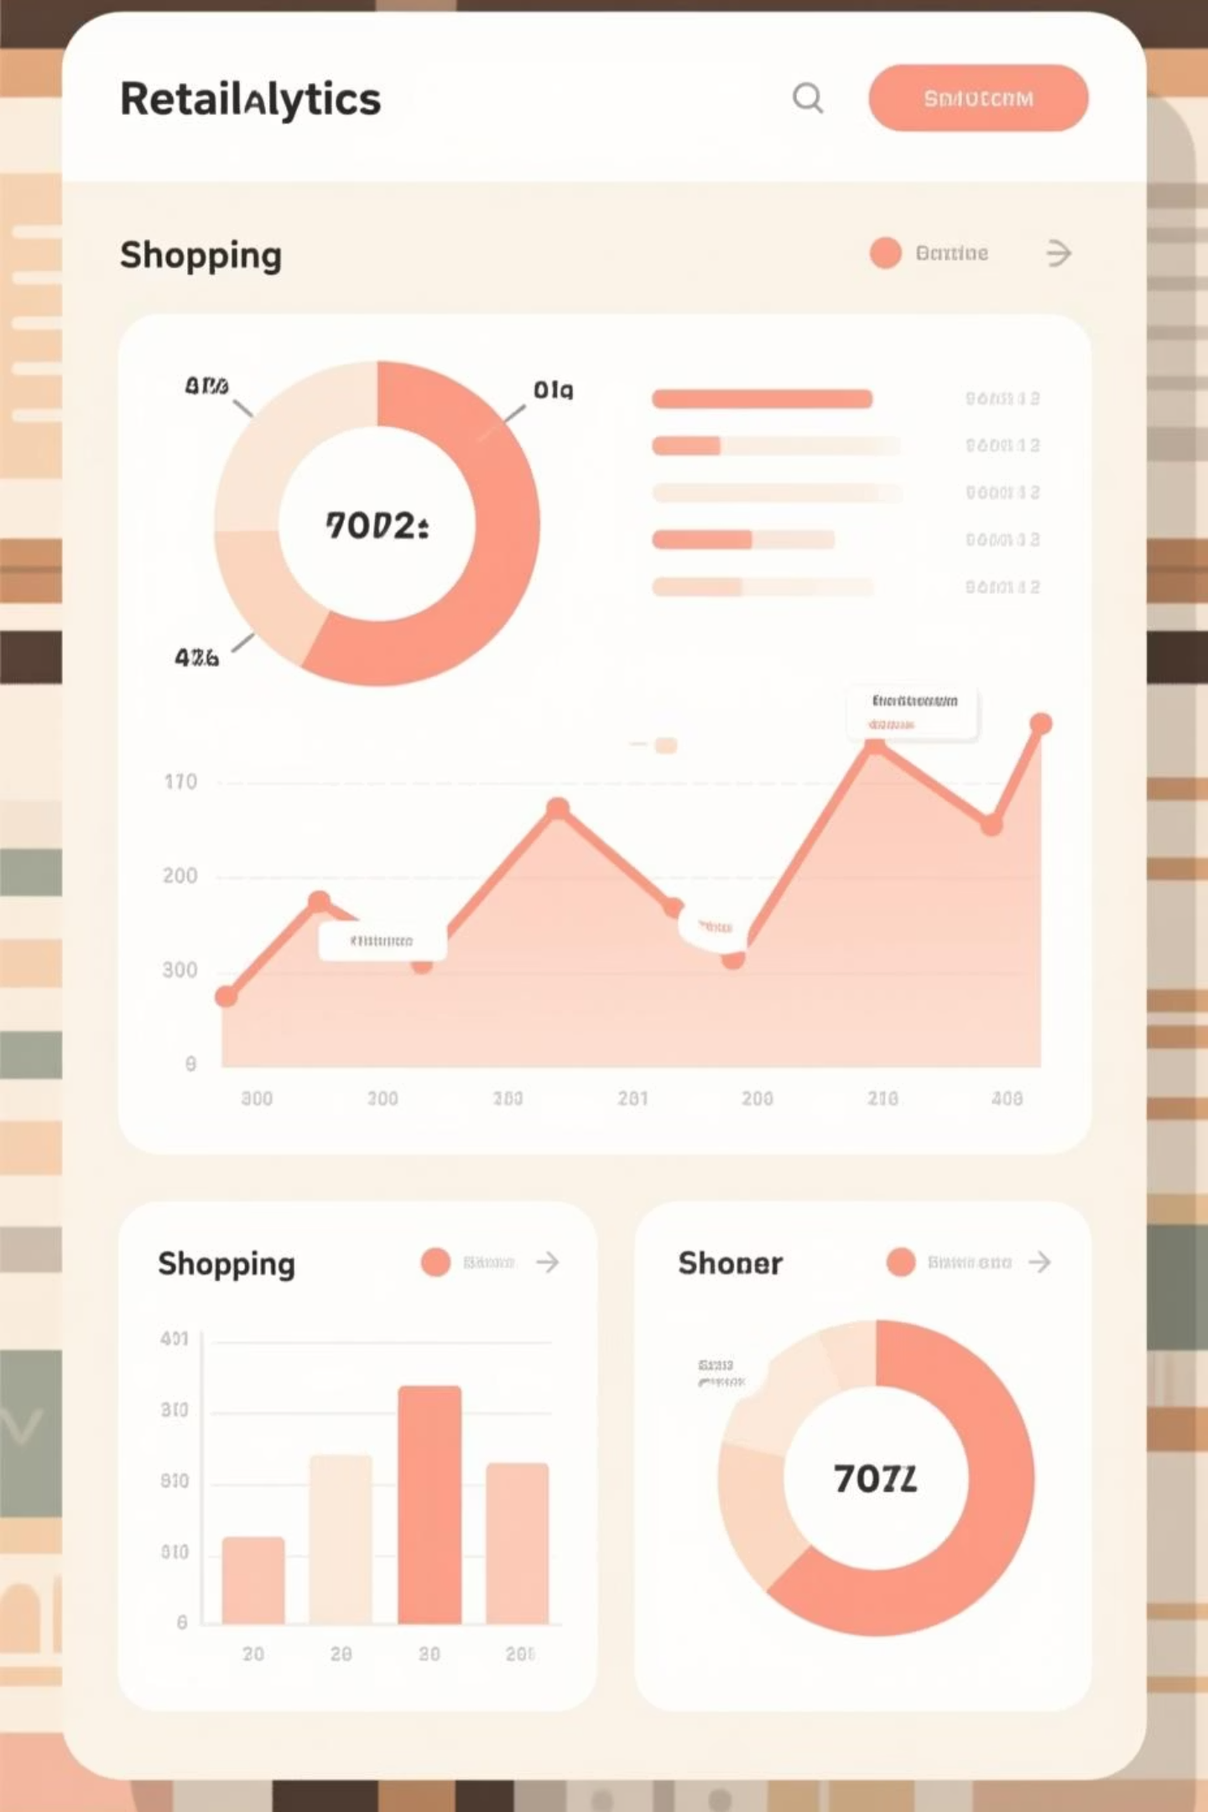
Customer Shopping
Behavior Analysis
University Project:
Course: Bachelor of Computer Applications (Artificial Intelligence and Data Science)
University: OM STERLING GLOBAL UNIVERSITY
Group Members:
Paras (231020158024)
Umesh (231020158032)
Vivek (231020158019)
Harshit (231020158014)

Slide 2
Dataset Overview
Analyzing 3,900 customer transactions to uncover spending patterns, preferences, and strategic opportunities for business growth.
3,900
18
37
Total Purchases
Data Features
Missing Values
Transactions analyzed across multiple product categories
Comprehensive attributes covering demographics and behavior
Only in Review Rating column, handled via median imputation
Key features include customer demographics, purchase details, and shopping behavior metrics like discount usage, review ratings, and shipping preferences.

Slide 3

Data Preparation Process
01
Data Loading & Exploration
Imported dataset using pandas, examined structure with df.info() and summary statistics
02
Missing Data Handling
Imputed Review Rating nulls using median rating per product category
03
Feature Engineering
Created age_group and purchase_frequency_days columns for deeper analysis
04
Database Integration
Connected to PostgreSQL and loaded cleaned data for SQL analysis

Slide 4
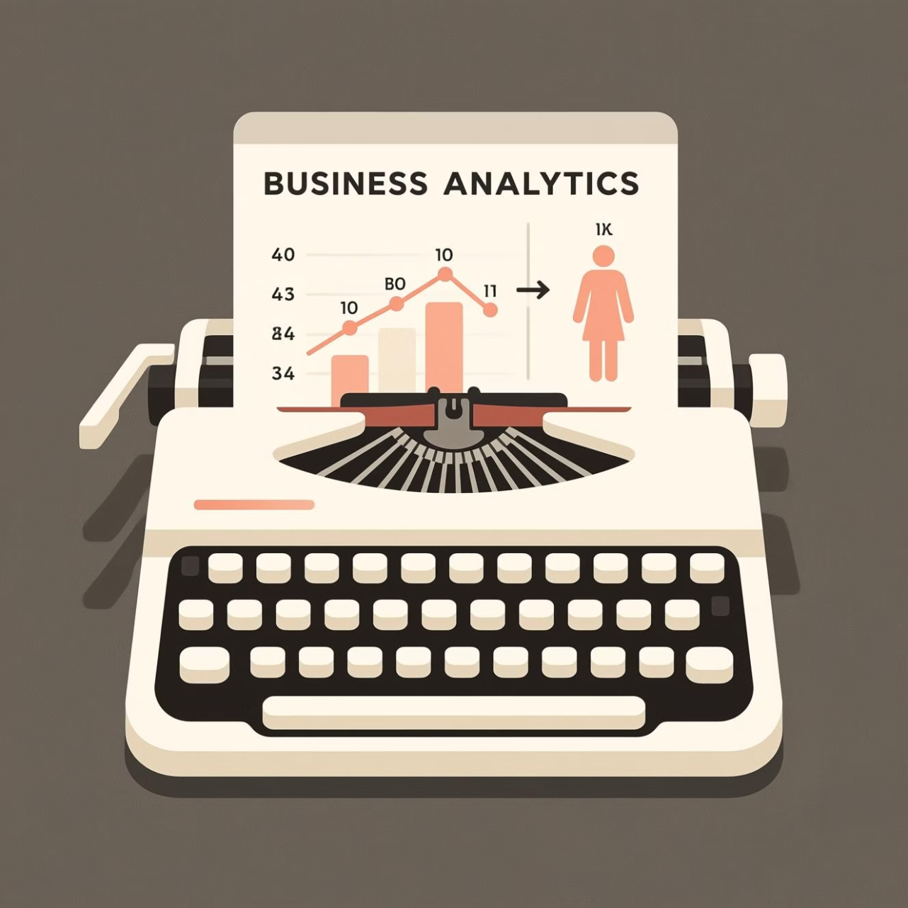
Revenue Insights by Gender
Analysis revealed significant differences in purchasing behavior between male and female customers. Understanding these patterns helps tailor marketing strategies and product offerings.
Gender-based segmentation provides actionable insights for targeted campaigns and inventory management decisions.

Slide 5




Discount & Spending Patterns
High-Spending Discount Users
Top-Rated Products
Found products with highest review ratings to guide promotional focus and inventory priorities
Identified customers using discounts while spending above average—prime targets for loyalty programs
Shipping Preferences
Express shipping users show higher average purchase amounts than standard shipping customers

Slide 6
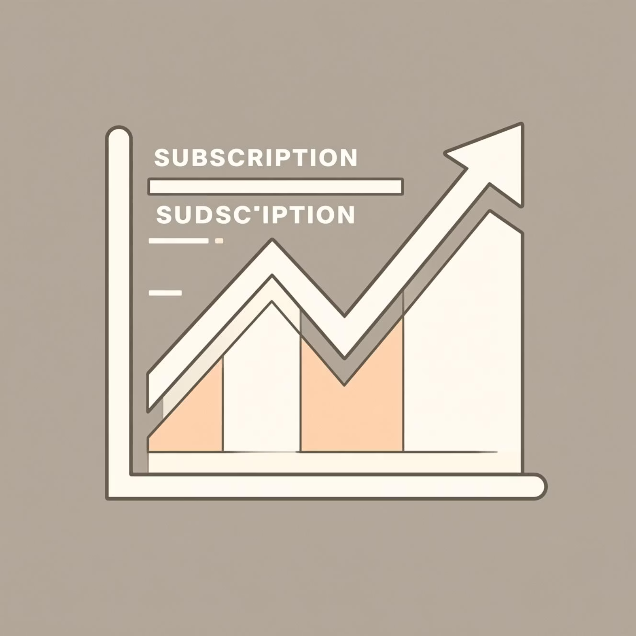
Subscription Impact Analysis
Subscribers vs. Non-Subscribers
Subscribers demonstrate significantly higher average spend and contribute more to total revenue.
Customers with more than 5 purchases show increased likelihood of subscribing, indicating a clear path to conversion.

Slide 7



Customer Segmentation
Loyal
1
Frequent buyers
Returning
2
Multiple purchases
New
3
First-time customers
Classification based on purchase history reveals distinct customer tiers. Moving customers up the pyramid through targeted engagement drives long-term value.

Slide 8
Product Performance Insights
Discount-Dependent Products
Top Products by Category
Revenue by Age Group
Calculated contribution of each demographic segment to guide targeted marketing efforts
Identified 5 products with highest percentage of discounted purchases—critical for pricing strategy review
Listed most purchased items within each category to optimize inventory and merchandising

Slide 9

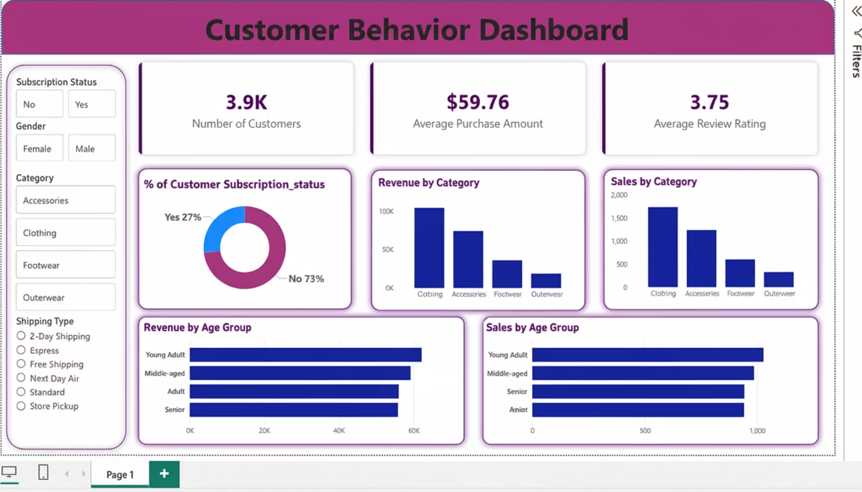
Interactive Dashboard
Built comprehensive Power BI dashboard presenting key insights visually. Interactive visualizations enable stakeholders to explore data dynamically and make informed decisions quickly.

Slide 10




Strategic Recommendations
Boost Subscriptions
Promote exclusive benefits to convert high-frequency buyers into subscribers
Loyalty Programs
Reward repeat buyers to move them into the "Loyal" customer segment
Review Discount Policy
Balance promotional sales boosts with margin control for sustainable growth
Targeted Marketing
Focus on high-revenue age groups and express-shipping users for maximum ROI

